Slide 1
Mechanical vibrations
Why do we study ?
• Vibrations are everywhere: • Human body: eardrums, vocal cords, walking and running • Vehicles: residual imbalance of engines, locomotive wheels • Rotating machinery: Turbines, pumps, fans, reciprocating machines • Musical instruments • Excessive vibrations can have detrimental effects: • Noise • Loosening of fasteners • Tool chatter • Fatigue failure • Discomfort

Slide 2
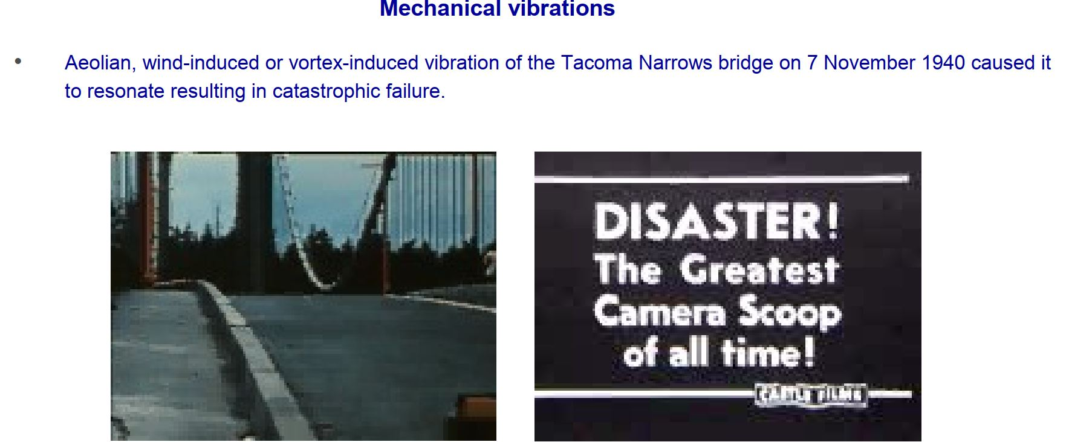

Slide 3
Basic Concepts of Vibration
All bodies having mass and elasticity are capable of vibration.
The mass is inherent of the body and elasticity causes relative motion among its parts.
When body particles are displaced by the application of external force, the internal forces in the form of elastic energy are present in the body. These forces try to bring the body to its original position.
At equilibrium position, the whole of elastic energy is converted into kinetic energy and body continues to move in the opposite direction because of it.
The whole of the kinetic energy is again converted into elastic or strain energy due to which the body again returns to the equilibrium position. In this way, vibratory motion is repeated indefinitely and exchange of energy takes place.
Thus, any motion which repeats itself after an interval of time is called vibration or oscillation.

Slide 4
Introduction
Mechanical vibration is the motion of a particle or body which oscillates about a position of equilibrium. Most vibrations in machines and structures are undesirable due to increased stresses and energy losses.
Time interval required for a system to complete a full cycle of the motion is the period of the vibration.
Number of cycles per unit time defines the frequency of the vibrations.
Maximum displacement of the system from the equilibrium position is the amplitude of the vibration.
When the motion is maintained by the restoring forces only, the vibration is described as free vibration. When a periodic force is applied to the system, the motion is described as forced vibration.
When the frictional dissipation of energy is neglected, the motion is said to be undamped. Actually, all vibrations are damped to some degree.

Slide 5
PARTS OF VIBRATING SYSTEM
A vibratory system basically consists of three elements, namely the mass, the spring and damper.
In a vibrating body there is exchange of energy from one form to another.
Energy is stored by mass in the form of kinetic energy (1/2 mv² ), in the spring in the form of potential energy (1/2 kx² ) and dissipated in the damper in the form of heat energy which opposes the motion of the system.
Energy enters the system with the application of external force known as excitation.
The excitation disturbs the mass from its mean position and the mass goes up and down from the mean position.
The kinetic energy is converted into potential energy and potential energy into kinetic energy.

Slide 6
7. This sequence goes on repeating and the system continues to vibrate.

Slide 7
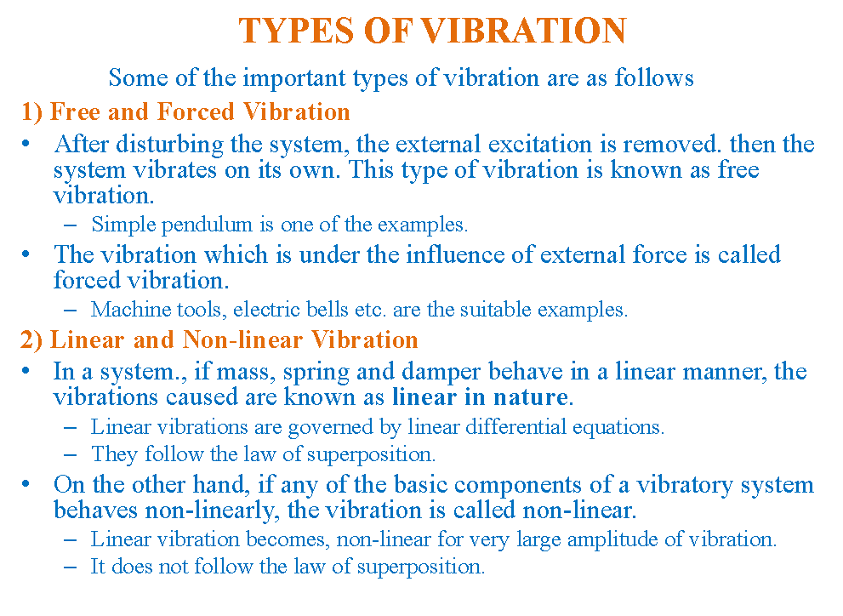

Slide 8
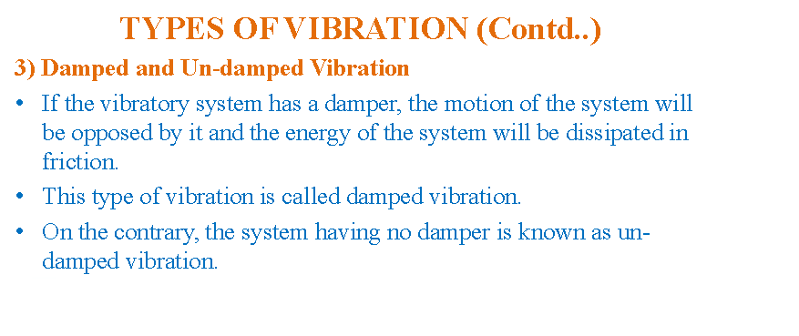
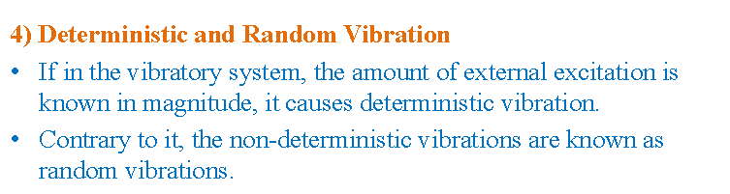

Slide 9
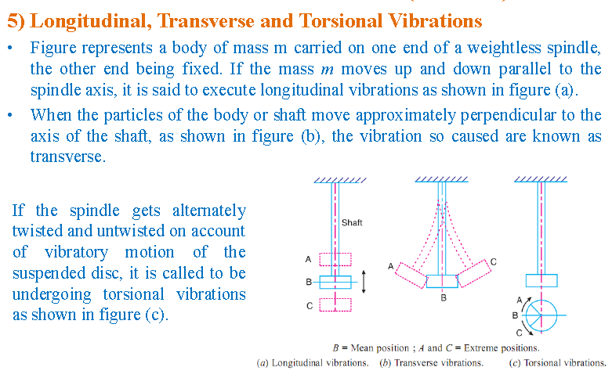

Slide 10
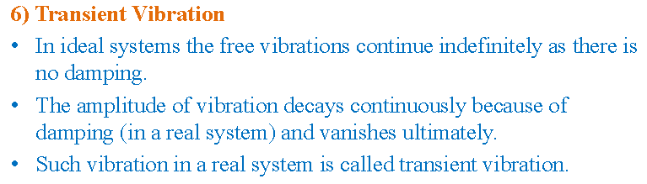
7) Un-damped free vibrations
When the elastic system vibrates because of inherent forces and no external force is included ,it is called free vibration.
If during vibrations there is no loss of energy due to friction or resistance it is known as un-damped vibrations.

Slide 11
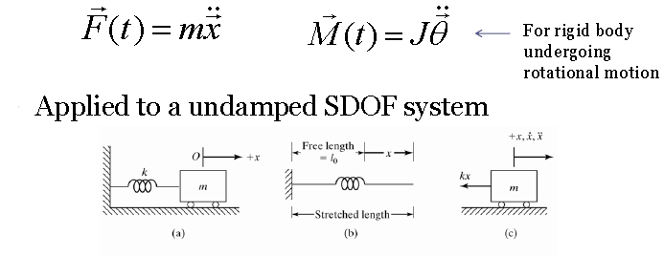
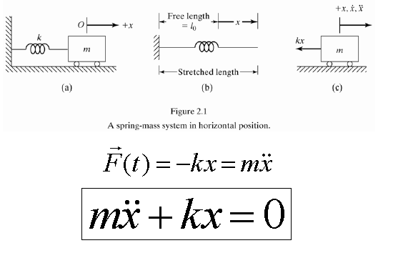
DERIVATION OF DIFFERENTIAL EQUATION
Newton’s Method

Slide 12
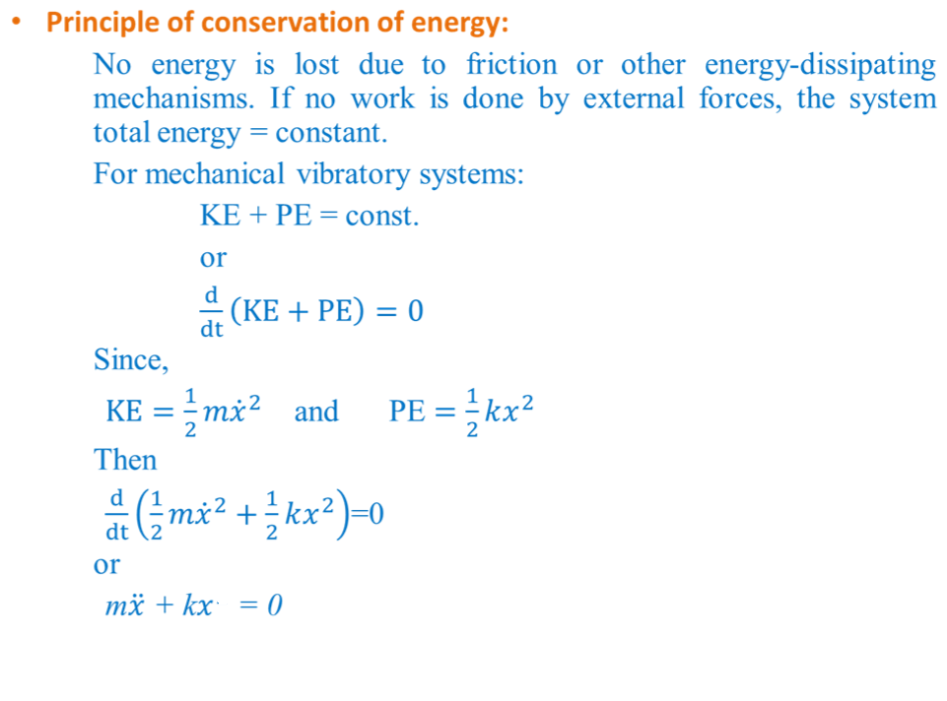
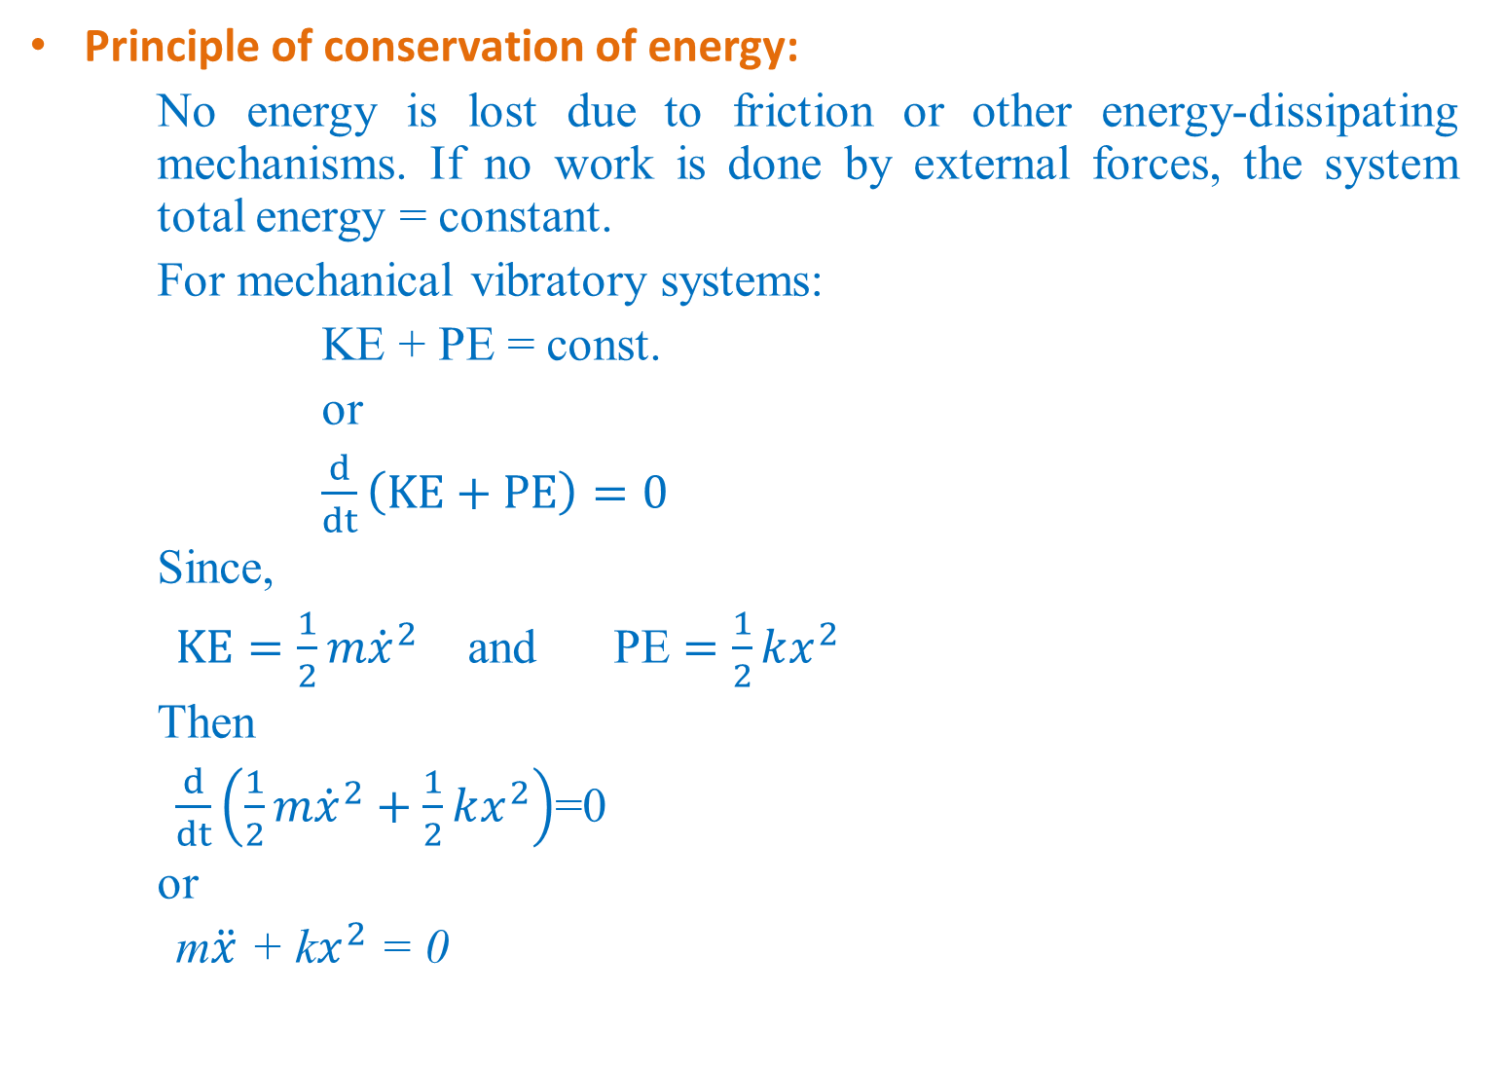

Slide 13
DAMPED VIBRATIONS
Damping is resistance offered by a body to motion of vibratory system.
Resistance can be applied by a liquid or solid internally or externally.
Mass, stiffness and damping are main features of vibratory system.
At start of vibratory motion, amplitude of motion is maximum which goes on decreasing and finally lost completely.
Main advantage of damping is just to control amplitude of vibration so that failure occurring due to resonance can be avoided.

Slide 14
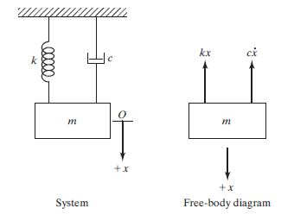
DIFFERENTIAL EQUATION OF DAMPED FREE VIBRATION
Viscous damping force F is proportional to the velocity or v and can be expressed as
c is the damping constant or coefficient of viscous damping
Negative sign indicates that the damping force is opposite to the direction of velocity

Slide 15

If x is measured from the equilibrium position of the mass m, the application of Newton’s law yields the equation of motion:
we assume a solution in the form x(t) = Ce^{st}
where C and s are undetermined constants. Inserting this function into equation of motion
leads to the characteristic equation ms² + cs + k = 0

Slide 16

Thus the general solution is given by a combination of the two solutions x₁(t) and x₂(t):

Slide 17
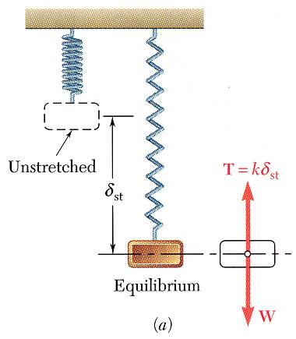
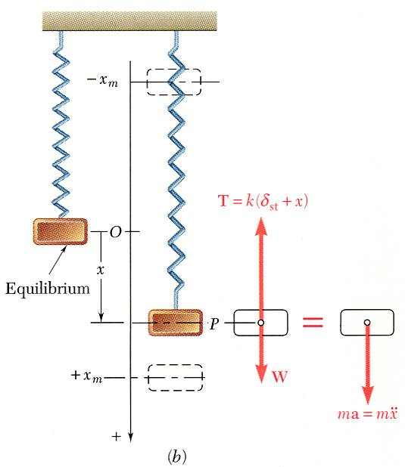
Free vibrations – Simple Harmonic motion
If a particle is displaced through a distance x_{m} from its equilibrium position and released with no velocity, the particle will undergo simple harmonic motion,
General solution is the sum of two particular solutions,
x is a periodic function and ω_{n} is the natural circular frequency of the motion.
C₁ and C₂ are determined by the initial conditions:

Slide 18
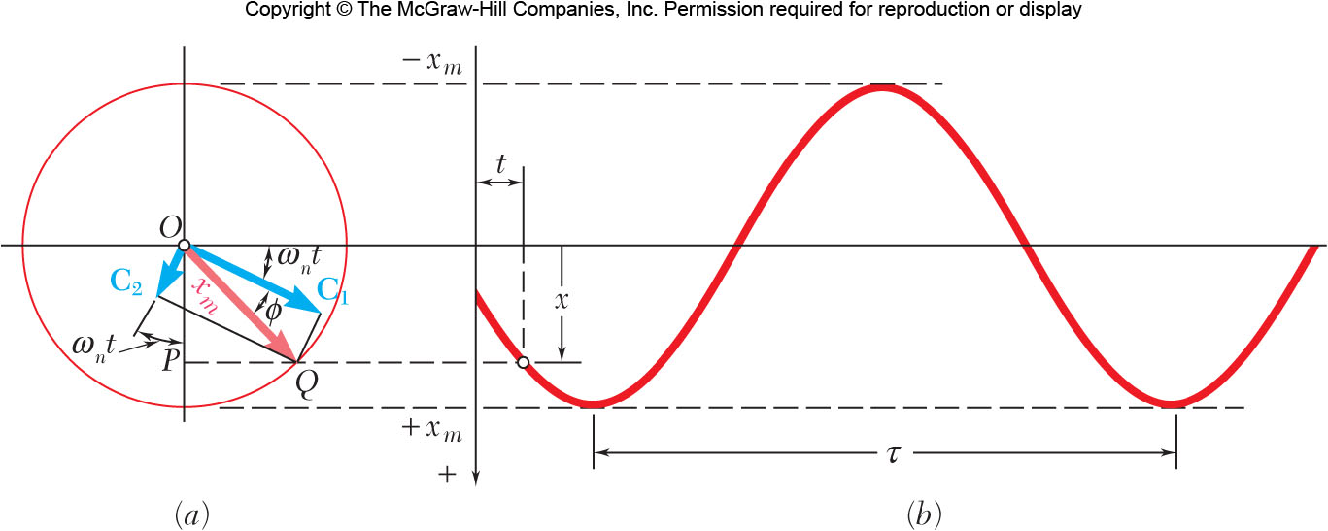
amplitude
phase angle
period
natural frequency

Slide 19
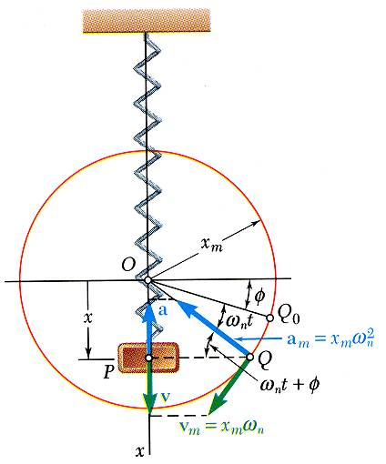
Free Vibrations of Particles. Simple Harmonic Motion
Velocity-time and acceleration-time curves can be represented by sine curves of the same period as the displacement-time curve but different phase angles.

Slide 20
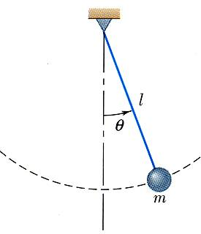
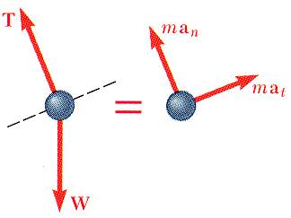
Simple Pendulum (Approximate Solution)
Results obtained for the spring-mass system can be applied whenever the resultant force on a particle is proportional to the displacement and directed towards the equilibrium position.
Consider tangential components of acceleration and force for a simple pendulum,
for small angles,

Slide 21
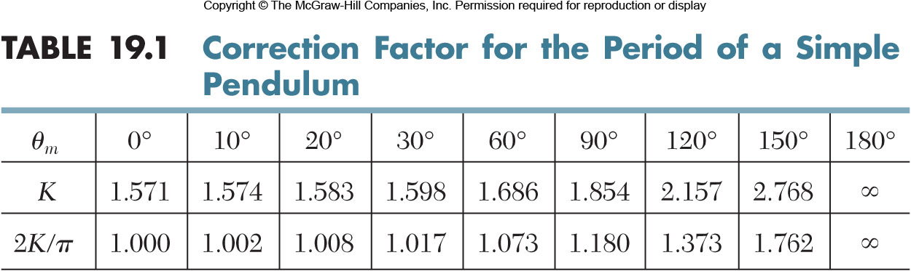
Simple Pendulum (Exact Solution)
An exact solution for
leads to
which requires numerical solution.

Slide 22
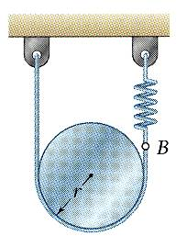
Sample Problem
SOLUTION:
From the kinematics of the system, relate the linear displacement and acceleration to the rotation of the cylinder.
k
Based on a free-body-diagram equation for the equivalence of the external and effective forces, write the equation of motion.
A cylinder of weight W is suspended as shown.
Determine the period and natural frequency of vibrations of the cylinder.
Substitute the kinematic relations to arrive at an equation involving only the angular displacement and acceleration.

Slide 23
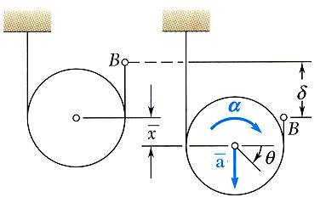
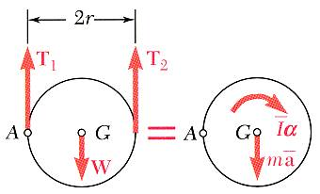
Sample Problem
SOLUTION:
From the kinematics of the system, relate the linear displacement and acceleration to the rotation of the cylinder.
Based on a free-body-diagram equation for the equivalence of the external and effective forces, write the equation of motion.
Substitute the kinematic relations to arrive at an equation involving only the angular displacement and acceleration.

Slide 24
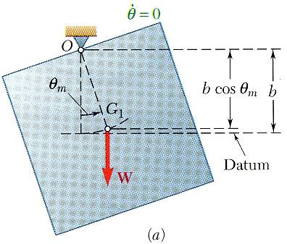
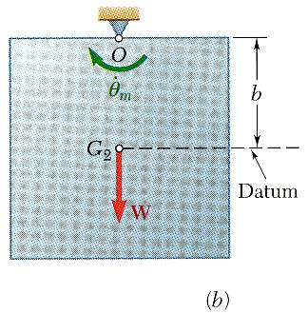
Principle of Conservation of Energy
Resultant force on a mass in simple harmonic motion is conservative - total energy is conserved.
Consider simple harmonic motion of the square plate,

Slide 25
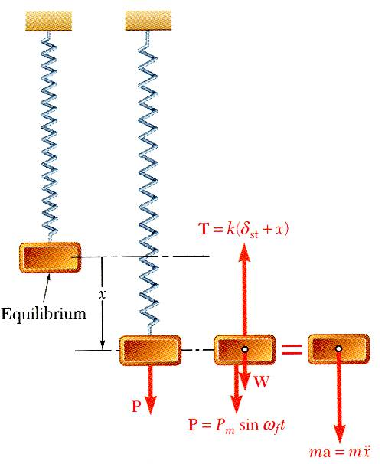
Forced Vibration..(Introduction)
Forced vibrations - Occur when a system is subjected to a periodic force or a periodic displacement of a support.
forced frequency

Slide 26
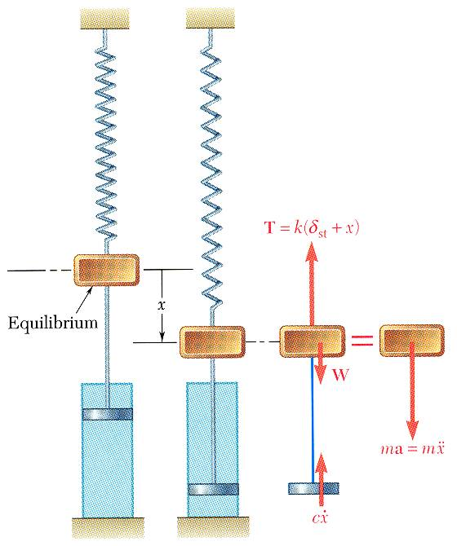
Damped Free Vibrations
All vibrations are damped to some degree by forces due to dry friction, fluid friction, or internal friction.
With viscous damping due to fluid friction,
Substituting x = e^{λt} and dividing through by e^{λt} yields the characteristic equation,
Define the critical damping coefficient such that

Slide 27
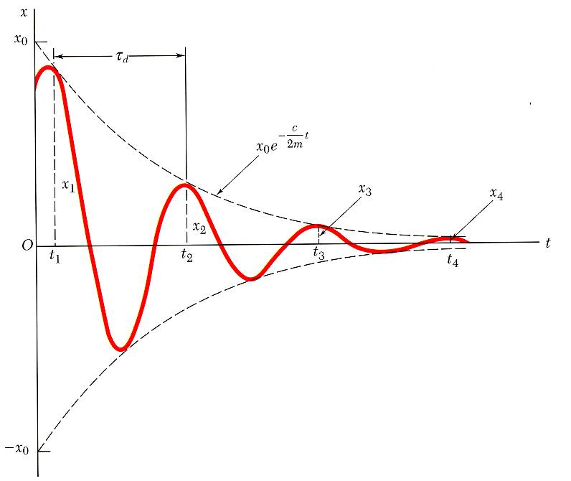
Damped Free Vibrations
Characteristic equation,
critical damping coefficient
Heavy damping: c > c_{c}
- negative roots
- nonvibratory motion
Critical damping: c = c_{c}
- double roots
- nonvibratory motion
Light damping: c < c_{c}
damped frequency

